Slide 1
Software Documentation
Chapter Two
Writing to Teach
Tutorial
Fatima M. AbuHjeela

Slide 2
Writing to Teach-Tutorial
A computer tutorial is an interactive software program created as a learning tool.
Tutorials help people learn new skills by using a step-by-step process that ensures the user is following along and comprehending the material.
The purpose of a tutorial is to accommodate information to the needs of the user.
Tutorial is associated with novice, beginner users , who want to learn the fundamentals of the program.
Tutorial also can serve experienced or advanced users as quick, first introduction to new software.
Fatima M. AbuHjeela

Slide 3
Writing to Teach-Tutorial
The tutorial document because of the intense contact between teacher and learner requires a design of text and graphical information that supports a highly focused lesson or module rather than giving the reader options.
When trying to teach skills, rely on your memories of your own learning and the difficulties you had with new software, and then you combine your memories with observation of others .
Be confident that your design follows the principles of task-oriented documentation.
Fatima M. AbuHjeela

Slide 4
Guidelines for Designing Tutorials
Identify user actions you need to support.
State objectives as real-world performance.
Choose the right type of tutorial.
Present skills in a logical, cumulative structure.
Offer highly specific instructions.
Allow practice and feedback at each skill level.
Test your tutorial (usability testing with real clients)
Fatima M. AbuHjeela

Slide 5
1- Identify User Actions You Need to Support
You should rely on a thorough user analysis to help you identify what skills you need to teach.
You need to define the action or scenarios that users would participate in.
The designer need to decide on the skills that he/she wants to teach in support of the scenario.
For each action you will teach:
    list the program skills that the user needs .
    Identify the commands that the user should associate with the skill.
    Put workplace task and program skill together.
Fatima M. AbuHjeela

Slide 6
1- Identify User Actions You Need to Support
Connecting Program Features to the User Actions:
When selecting program features, you must follow these guideline:
Central to job performance:
  Users may care more and want to learn more about certain features they perceive as essential to problem solving on the job.
  Look for features like reporting or printing ,or feature relating to the users 'communication or information transfer needs.
Essential for efficient software use:
  Some features, security, file management etc must be taught.
  Always teach the basic concepts specific to the program.
Frequency of performance:
  Some features occur so frequently that you will want to teach them to the user.
Fatima M. AbuHjeela

Slide 7
2- State Objectives as Real-World performance
Objectives should appear as skills that the user should learn as a result of the tutorial.
Often objectives sound like “ in chapter x, you will learn the following skill…” so tell the user what he or she will learn from the lesson.
put the objectives in measurable terms ex. “ this lesson will teach you to create a drawing with three colors”.
At the end review the objectives and direct toward the next lesson.
Fatima M. AbuHjeela

Slide 8
3- Choose the Right Type of Tutorial
Tutorials come in many forms, from very brief one to full-scale manuals, and they occur in both print and online media.
1. Guided Tour
2. Demonstration
3. Quick Start
4. Guided Exploration
5. Instructional Manual
Fatima M. AbuHjeela

Slide 9
3- Choose the Right Type of Tutorial
1. Guided Tour:
It presents an overview of all the program main features and user actions features that informs and the user as to the usefulness of the program in a low-interaction environment.
For beginning and intermediate user.
Provide little user interaction other than clicking for the next frame.
It tells the program features and it also helps convince the user of the usefulness of the program.
Print guided tours consists of a booklet or sections highlighting the program prominent feature.
Online guided tour can include sound and animated cartoon
http://www.mediawiki.org/wiki/Extension:GuidedTour
Fatima M. AbuHjeela

Slide 10
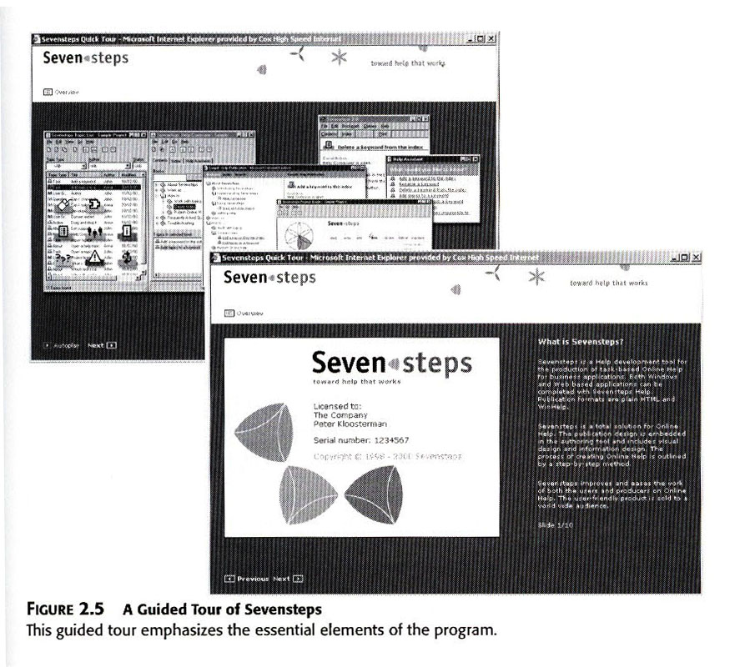
Fatima M. AbuHjeela

Slide 11
3- Choose the Right Type of Tutorial
2 . The Demonstration:
Mainly for beginning and intermediate users.
When you want to illustrate some specific parts of a program that emphasize a real -world application of a program or an important user case.
It is a more focused presentation of a particular program function being performed, which tends to be passively viewed by users.
Online, the demonstration shows you a procedure, allowing you to choose which procedure to see.
You can link the demonstration to the help system via a button .
Fatima M. AbuHjeela

Slide 12
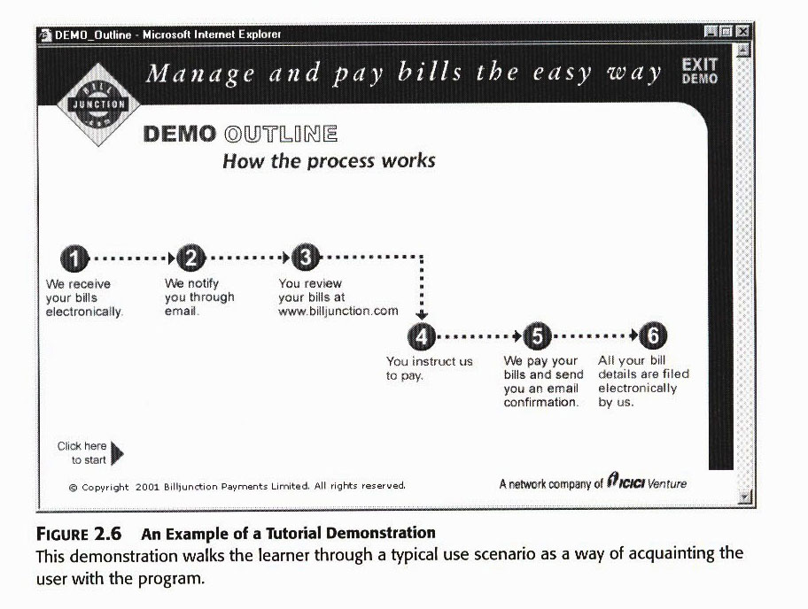
Fatima M. AbuHjeela

Slide 13
3- Choose the Right Type of Tutorial
3 . The Quick Start
Mainly for intermediate and advanced users with domain knowledge who want to get going with a program, who want to explore.
It involve significant user interaction with the program itself .
They help users get down to work without going into complicated configuration procedures .
It consists of one-page or folder cards and booklets that explain how to start program and list of sampling of commands.
Fatima M. AbuHjeela

Slide 14
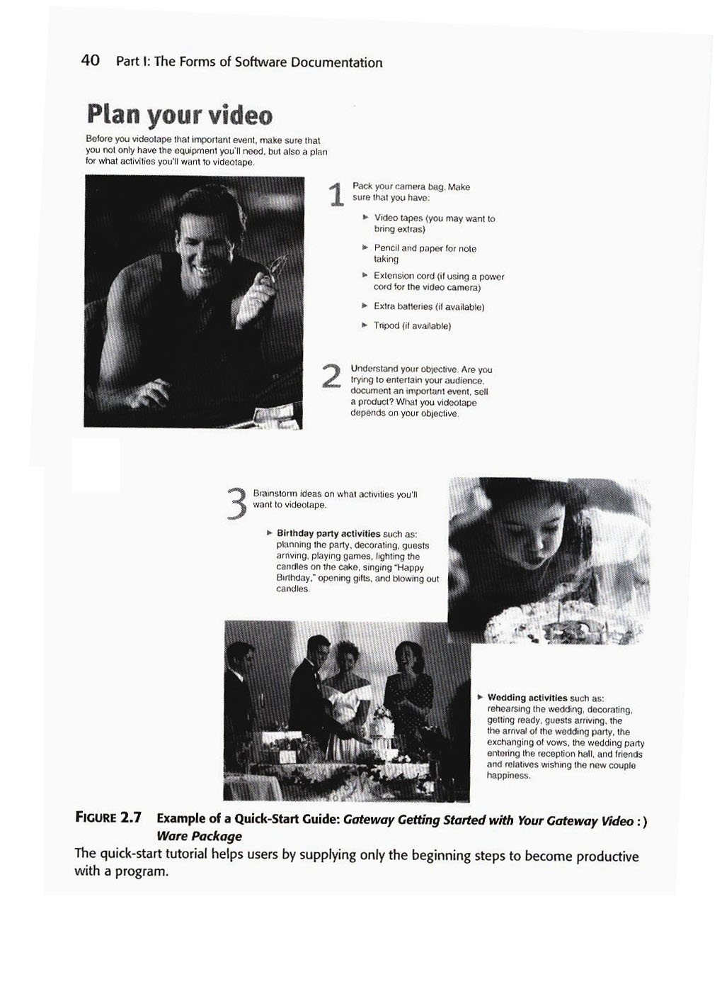

Slide 15
3- Choose the Right Type of Tutorial
4 . The Guided Exploration
Mainly for beginners and intermediate users.
This kind of tutorials contain instructions for the user to “try out” commands which encourage exploration of the program, but don’t limit the user as to exactly what to do.
It contains a little discussion to give the users the experience they need.
It guides a user through a procedure, but allows for some
experimentation on their own.
Usually it takes a form of short tutorial manuals, may or may not provide some scenarios (examples to follow), may include objectives and summaries to give the user direction but do not constrain him to learn specific commands.
Fatima M. AbuHjeela

Slide 16
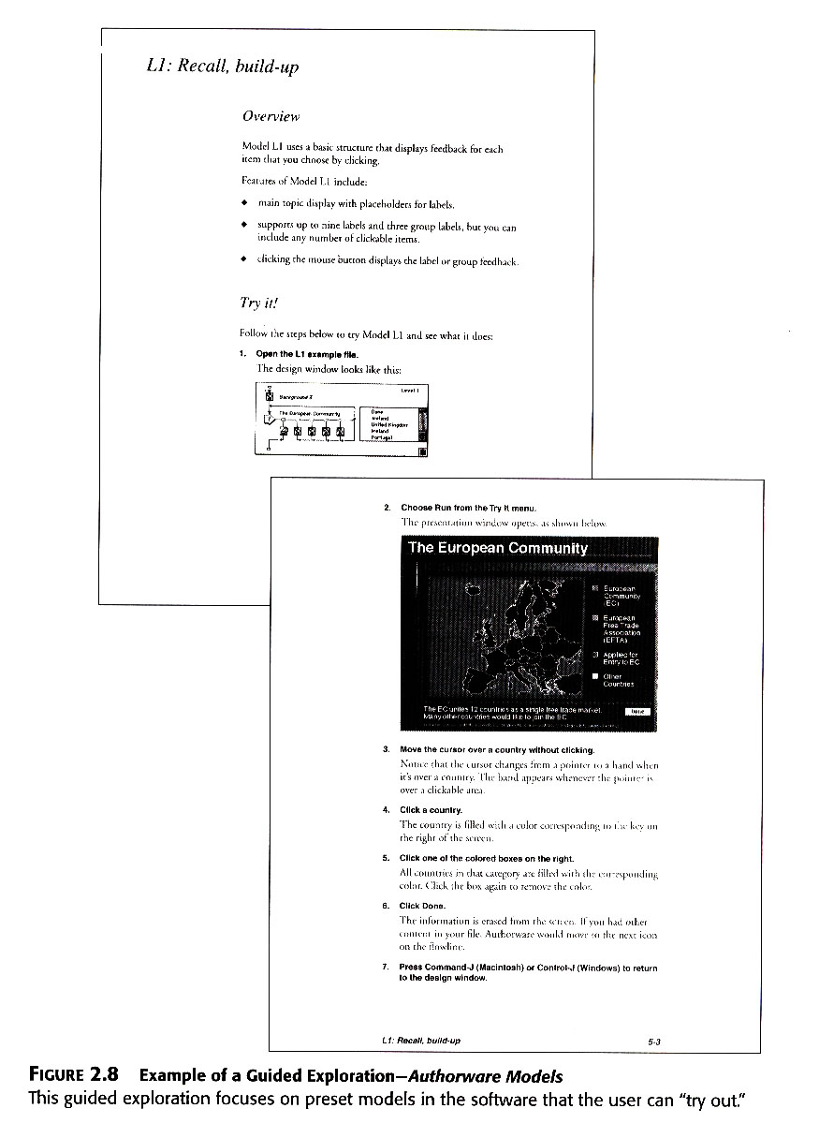

Slide 17
3- Choose the Right Type of Tutorial
4 . The Instruction Manual
Mainly for users of all levels.
It attempts to teach as much of the software as possible through a full series of interactive lessons.
It consists of lessons, each focuses on specific objective, usually tied with specific set of command.
It focuses on users who intend to operate a program or expect to have to learn a number of complicated commands and functions.
This type of teaching relies on the principles of accumulative learning, you learn one skill before you take on another, more advanced one.
This kind of tutorial contains a great deal of user interaction, but not as much as the guided exploration, often contains practice sessions and/or evaluation test to see if the user learn the materials.
http://programmedlessons.org/VectorLessons/vch01/vch01_1.html
Fatima M. AbuHjeela

Slide 18
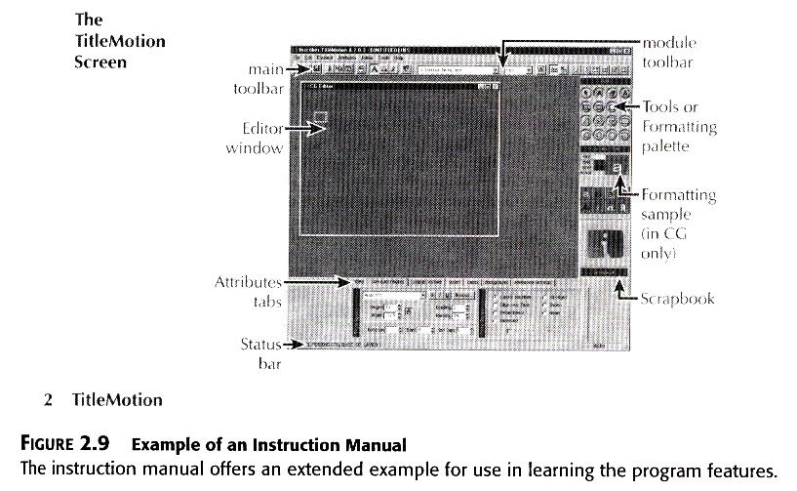

Slide 19
4-Present Skills in a Logical, Cumulative Structure
You would need to assemble the lessons in a logical order and structure.
Order and structure should follow typical-use scenario or some other user action that you think most likely resembles what most users would perform.
Some Logical or cumulative structures include:
  Beginning to advanced.
  Simple to complex.
  Generalized to specialized.
  Starting a session to ending a session.
  Using default options to using customized options.
Fatima M. AbuHjeela

Slide 20
5- Offer Highly Specific Instructions
Instruction or lessons should focus on a specific scenario or problem that the user would recognize.
Avoid distraction that cause the learner to lose concentration ,make sure you carefully edit your screens to eliminate any extraneous images, extra files, extra menu items- all the stuff that can distract your user.
Do what you can to not draw attention to details of page design .
Keep them on track with specific instructions, such as the following:
  Specific Data: Numbers, Names, words, variables etc.
  Tools: : Mouse buttons, icons, radio buttons, hypertext links etc.
  Screens: Displays, highlighted areas, data fields, menu selections
  Commands : Control commands, keyboard shortcuts, function keys etc.
Fatima M. AbuHjeela

Slide 21
6- Give Practice and Feedback at Each Skill Level
State goals positively and avoid controversial jargons.
Remind the user of the reward for understanding and correct performance, or use the conclusion of the lesson to help you establish a feeling of goodwill.
Example: “This is the end of the Console program guided tour. Thanks for coming in and we hope you enjoy the rest of your trip”
Imagine you can lean over the user’s shoulder and point to the screen.
Example: “Notice that ………”,
“ see how the……..”
Fatima M. AbuHjeela

Slide 22
6- Give Practice and Feedback at Each Skill Level
Build a pattern of expositions:
Repeat the following rhythm:
      Give action to take, “select Open.. From the file menu
      Explain the result, “ the program will display an empty file.”
      Give feedback :by including exercises , quiz or questions and answer.
Pace(walk with slow regular steps) the tutorial:
  keep lessons down to a bout 10-12 minutes each, this will help
  them concentrate well.
  Don’t waste user time.
Fatima M. AbuHjeela

Slide 23
7- Test Your Tutorial
  You should base your testing on the objectives of the tutorial.
  Design the test, also to focus on the design elements such the cuing
  system, the effectiveness of the graphics, and style of writing steps.
  If you do not have a real user try to mock-up the situation with
  someone of similar background as the user.
  Try out your tutorial and revise it based on the results.
Fatima M. AbuHjeela

Slide 24
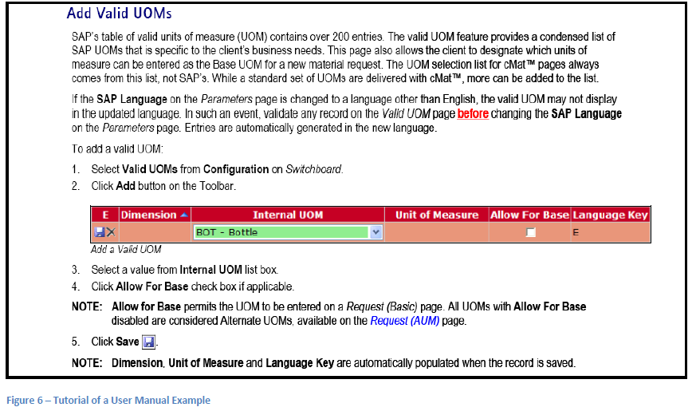

Slide 25
Designing Tutorial
Fatima M. AbuHjeela

Slide 26
Designing Your Tutorial
  You should start with the knowledge of how tutorials work, and when the user need them.
  Because not all documentation sets contains tutorials, we should know when to use this form of documentation, and when to apply others.
Fatima M. AbuHjeela

Slide 27
Designing Your Tutorial
There are Two Approach in Tutorial design :
  1. The Elaborative Approach:
  It includes elements of a good storytelling, examples, table of commands ,goals and objectives, summaries ,describe scenario carefully and slowly.
  You should always consider using this approach with novice users.
  The design of the elaboration manual follows the traditional principles of lesson design:
  1- Instruction results in articulated skills.
  2- Skills transfer capability to real world performance.
  3- Steps should present skills in a logical, cumulative structure.
  4- Highly specific instructions work best.
  5- Give practice and feedback at each skill level.
  6- Master one skill before you going to the next.
Fatima M. AbuHjeela

Slide 28
Designing Your Tutorial
  There are Two Approach in Tutorial design :
  2. The Minimalist Approach:
    This approach apply a realistic view of human behavior.
    Researchers makes the following observation about user behavior of learning software programs:
      1. Users jump the gun:
      They like to get start right away and they resist to read info for introduction or orientation.
      2. Users will skip info:
      They flipped quickly through the first pages of manuals.
      3. Users like to lead:
      People like to create their own perspective on their training, they like to take charge of situation, they like to control and don’t like manipulative instructional strategies.
Fatima M. AbuHjeela

Slide 29
  The Minimalist Approach Principles
  1- Choose an action oriented approach:
    Focus on real tasks and activities ,because users prefer to do something with a piece of software rather than learn about it .
  2- Anchor the tools in the task domain:
    Identify tasks that come not from the software itself ,but from the user’s workplace.
  3- Support Error Recognition and recovery:
  You should make it easy for user to get out of trouble, you should find out the common errors and try to include info for recovering from mistakes. Turn the user loose ,but give the steps to recover. “ if you make a mistake typing, use the backspace key”, also “ you can always restart the system without damaging the data”.
  4- Support reading to do, study, and locate:
  people like to go their own way, so encourage practice, “try it out”, they want to know what is inside the box, what happens if they press this key.
Fatima M. AbuHjeela

Slide 30
  Comparing the Elaborative and Minimalist Approaches
Criterion | Elaborative | Minimalist
Uses | highly abstract concepts, complicated procedures, large systems | getting started booklet, guided tours, demos, programs requiring creativity by the users.
Advantages | good for users who like structure, good for first time users, traditional. | cuts writing time, less document length, interesting.
Disadvantages | limits document writers to one or two scenarios, boring. | may frustrate the first time user, may backfire, increase testing time.
Fatima M. AbuHjeela

